Slide 1
DT282 3 Project Management
MS Project

Slide 2
Project Management
Project management is the process of planning, organizing, and managing tasks and resources to accomplish a defined objective usually within limitations on time, resources, or cost.
Three Phases involved in it are
Build the project plan
Track and Manage the Project
Communicate or Close the Project
Never lose sight of the following:
Time The time required to complete the project.
Money The Project budget, based on the cost of the resources (people, equipment, materials)
Scope The goals and tasks of the project and the amount of work required to complete it.

Slide 3
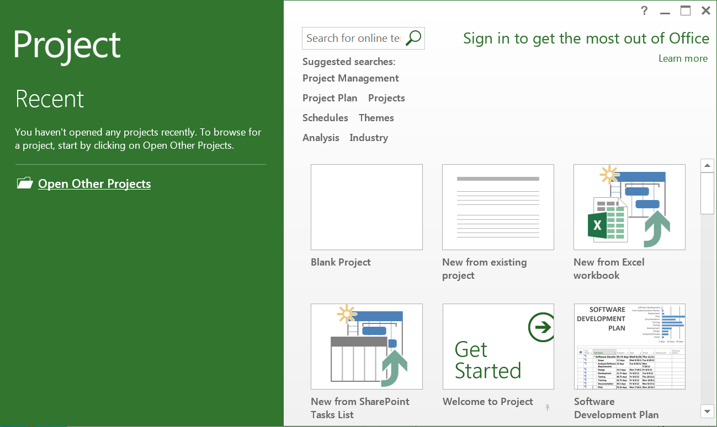
MS Project
Select Blank Project

Slide 4
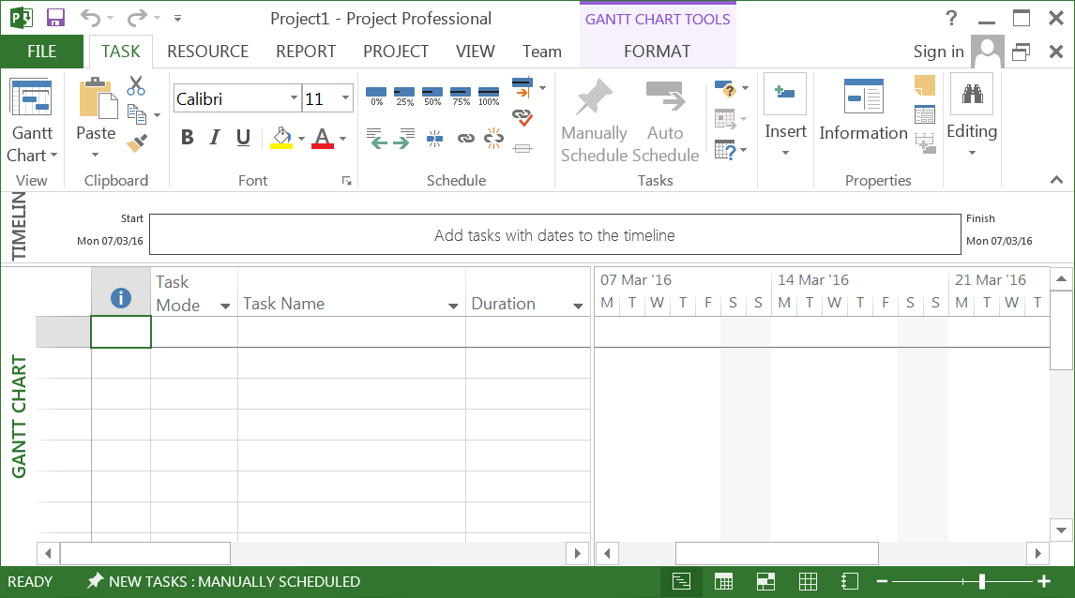
The Project Screen
MS Project displays information in various views. We will be using the default view – the Gantt Chart
The screen consists of the Title Bar, Menu Tabs and Toolbars

Slide 5
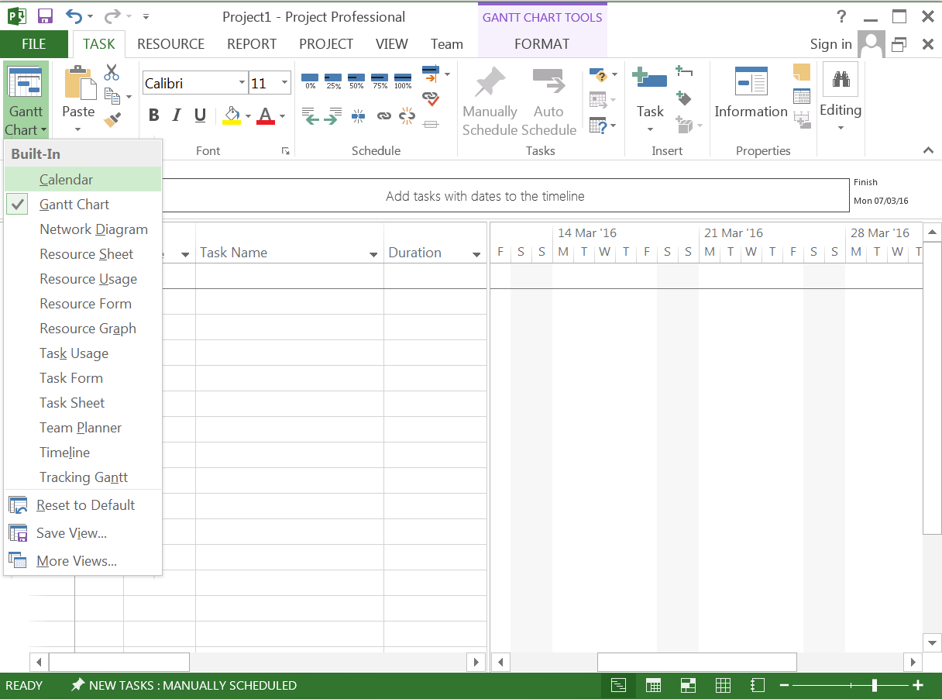
Menus and Toolbars
As we will be using the view menu a lot it is good practice to open it along the side of the page by selecting: Gantt Chart

Slide 6
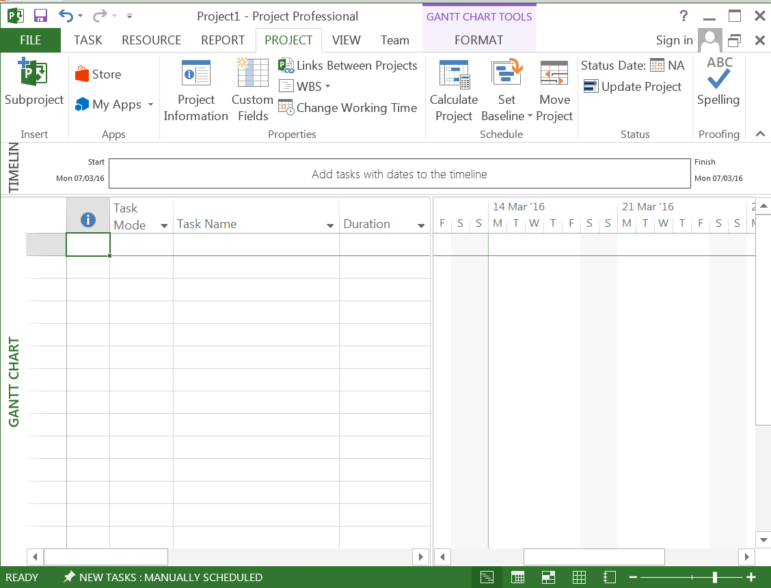
The Project Properties 1
Select Project Tab, then Project information

Slide 7
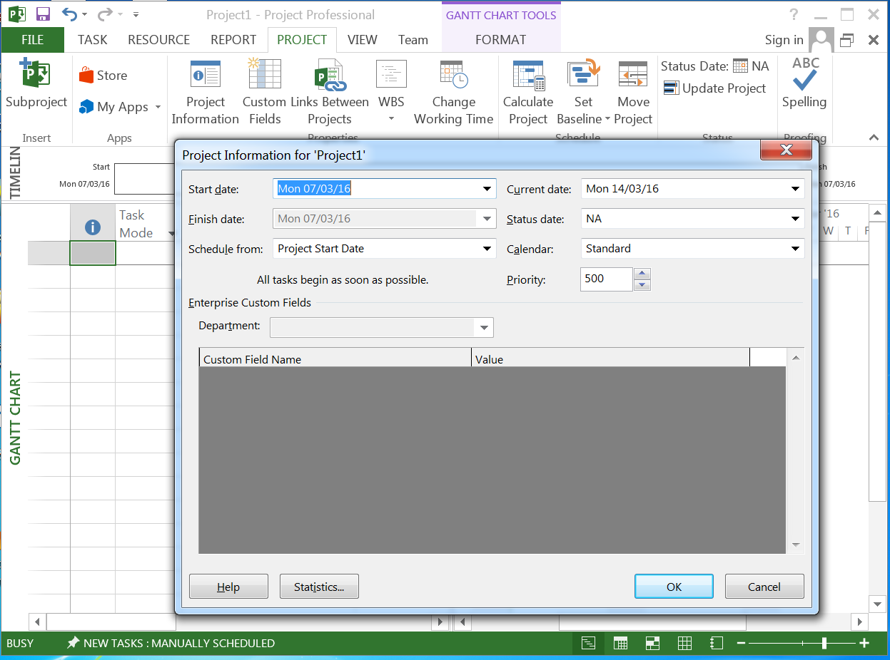
The Project Properties 2
Set the file properties up to reflect your project details

Slide 8
Tasks
The first step in any project requires the project team to scope out the project, i.e. to broadly identify the high level tasks that need to be completed in order to close out the project.
MS Project facilitates this as the high level tasks can easily be captured
These tasks can then be expanded to include the sub-tasks required to move the project forward
High level tasks to make a movie could include:
Write script
Find location
Prepare filming
Shoot movie
Release Movie
These tasks can then be broken down into sub-tasks

Slide 9
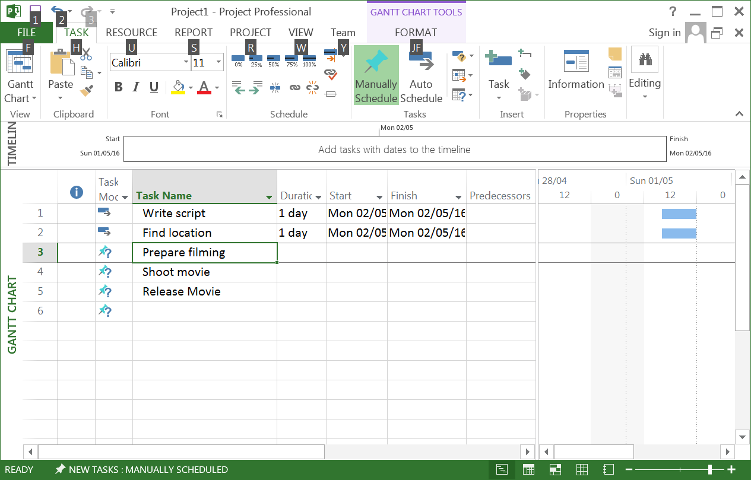
Entering Tasks
Tasks are entered into the Task Name column as shown
To move from task to task use the ENTER key or down arrow ▼
The duration of the task is shown as 1 day? by default – this can be then changed by the user. The ? mark indicates an estimate.
The duration of the task is then shown on the Gantt Chart

Slide 10
Manual and Auto Scheduling
Each task is manually scheduled by default.
This requires the user to enter more specific information
It does not make use of Power of Project
Change each task to auto schedule
Select the a single or group of Tasks
Click the auto schedule button
This can be done in advance of entering tasks or after tasks are entered.
Always change the task schedule to auto schedule

Slide 11
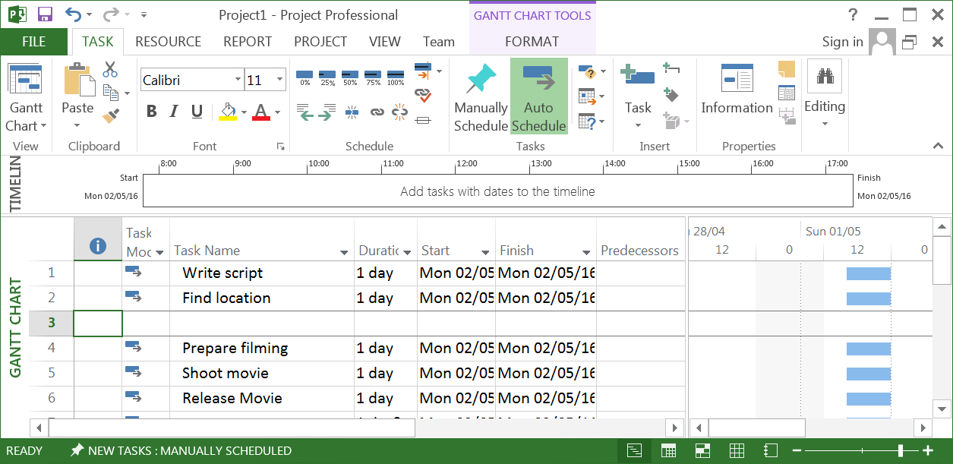
Inserting, Removing and Moving Tasks
To insert a task select the Task below where the insertion is to be made and press the INSERT key
To remove a Task click on the Task and press DELETE or use the menu EDIT | DELETE TASK
To move a Task click the row number to select the row and then drag and drop
Entries can also be cut and pasted by selecting the Task row

Slide 12
Assigning Durations to Tasks
Duration is the amount of time taken to complete a task and can have the units:
Months (mo)
Weeks (w)
Days (d)
Hours (h)
Minutes (m)
To enter a duration type the duration and unit in the duration cell. Follow this by a ? Mark if the duration is an estimate.
Add the following durations d = days (default) w = weeks and h = hours
Write Script 1 day – type 1 and press [ENTER]
Raise Finance 1 week – type 1w and press [ENTER]
Employ people 3 days
Find location 6 days
Shoot movie 3 weeks
Release movie 4 hours – type 4h and press [ENTER]

Slide 13
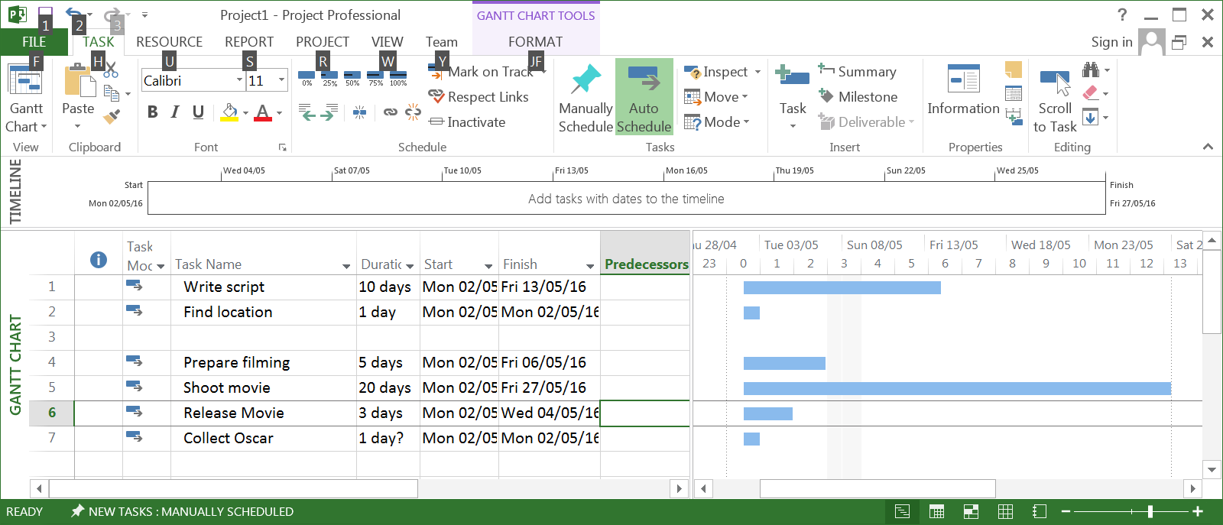
Duration Project Sheet
Saturday and Sunday are considered to be non-working days by default, however, this may be changed by the user. Notice that a task like Shoot Movie lasts 4 weeks using 5 working days per week so a total of 20 working days are required to complete this task.

Slide 14
Milestones
Milestones are control points used to track important events throughout a project
Examples of Milestones may be the start or finish of a project or phase of a project or some important event such as signing a contract or a key review point in a project.
Milestones can also be related to tasks or groups of tasks to demonstrate that they have been achieved and a Milestone or a Goal has been met.
Milestones are Tasks that are given zero duration and cost (resources are zero)
Milestones appear as black diamonds along with a date of when they are to occur
Modify the Make a Movie project to have two milestones
Make a Movie as the first task in the project
Movie Complete at the end of the project

Slide 15
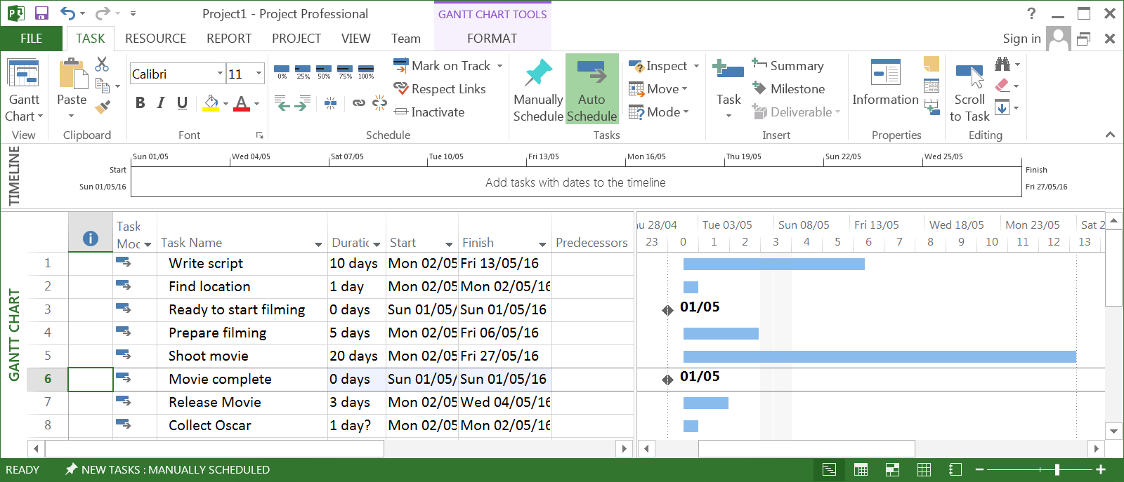
Milestones Entered
Realistic dates will appear beside the milestones as the project plan is developed

Slide 16
Adding detail through Subtasks
Each of the Tasks entered in to the project plan are at a high level
These have a number of activities associated with them in order to close them off
These activities are essentially Subtasks of the high level Task
The duration of a Task which has Subtasks is dependent on how long it takes to complete the all the Subtasks
In MS Project these Subtasks are handled just as we have handled Tasks
To enter a Subtask insert a Task under the Task you are working on. By INDENTING the new Task it becomes a Subtask
By grouping a number of Tasks under each other they can be turned into Subtasks by selecting them and then INDENTING
Task can be promoted from Subtask to Task by OUTDENTING

Slide 17
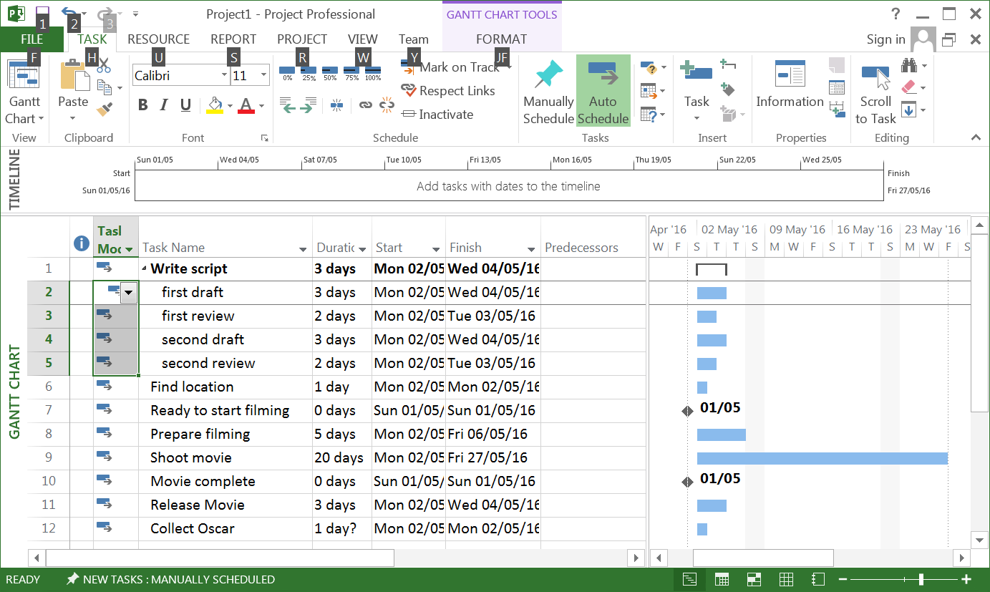
Entering Subtasks
We need to expand on Write a script in our project
To do this we enter the following Tasks and turn them into Subtasks
1st Draft 3 days
1st Review 2 days
2nd Draft 3 days
2nd Review 2 days
Complete Script 0 days (Milestone)
Select the 5 rows beneath the Task “Write Script” and press INSERT
Enter the details
Select the 5 rows again and click on the INDENT button
Save file as “Movie Project No Baseline”

Slide 18
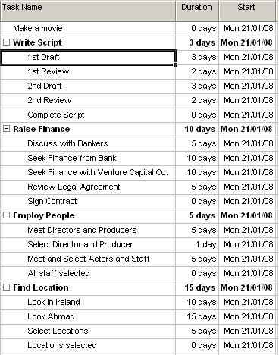
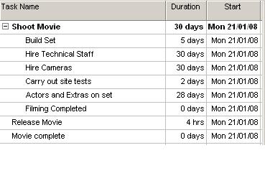
Insert all of the following Subtasks
Save as Movie Project No Baseline 3

Slide 19
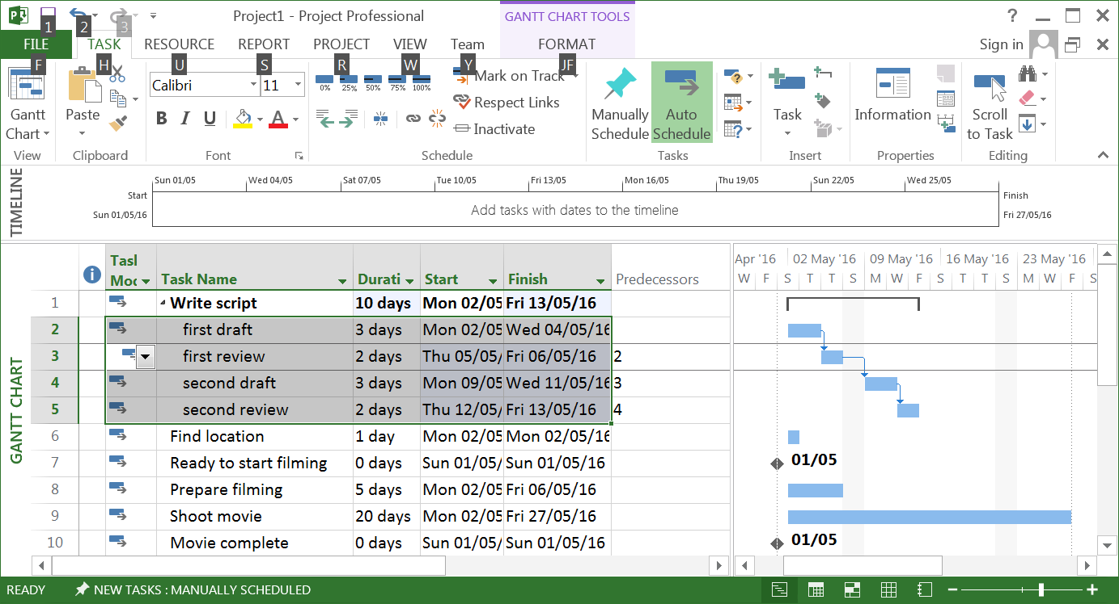
Linking Task and Subtasks 1
The project team must decide which tasks and subtasks are to take and in what order
MS Project allows us to schedule tasks and subtasks by Linking them together
Consider the subtasks under Write a Script
Obviously 1st Draft happens before 1st Review can take place etc.
To link these subtasks select subtasks 3 to 7 and click the Link button.

Slide 20
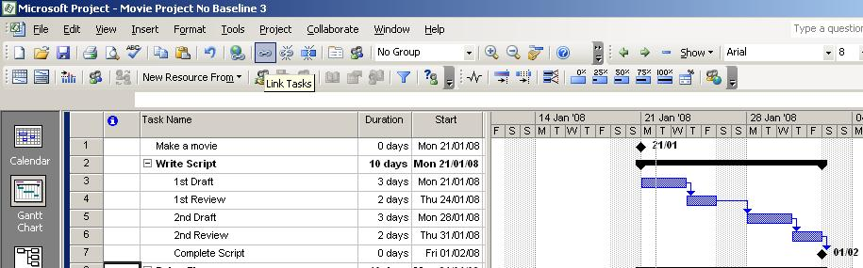
Linking Task and Subtasks 2
Once the Link Tasks button is clicked the Subtasks are linked in order of the Subtask number
The duration of each Subtask is used to determine how long the series of Subtasks will take
The completion milestones indicates that the completion date for the Task “Write a Script” will be 1st Feb.
Tasks may be unlinked by selecting them and clicking the Unlink Tasks Button.

Slide 21
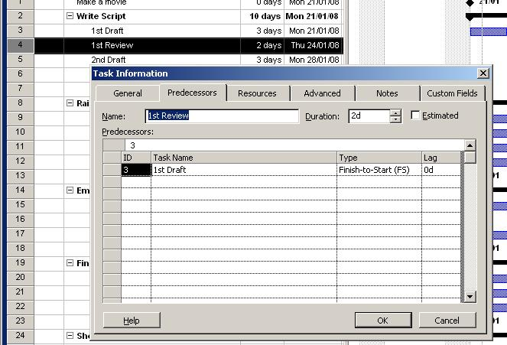
Task Information
The information associated with a Task can be accessed by double clicking on the Task Name. As you develop your skills using MS Project this box will become a source of much information for you.

Slide 22
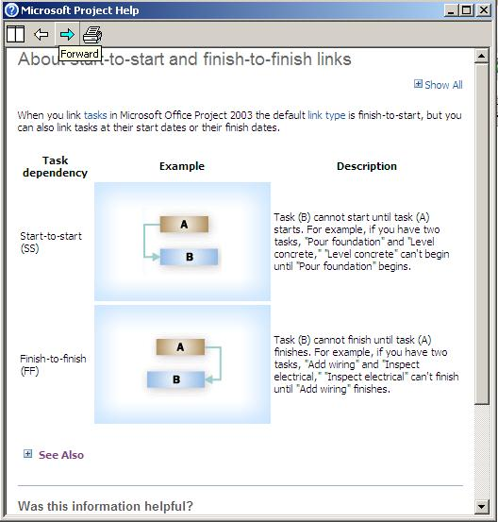
Finish-to-Start, Start-to-Start????
By default Tasks in MS Project are linked using a Finish-to-Start relationship
This means that the first task must be completed before the linked task can be started. (1 Draft before 1st Review)
However, complex projects can have a number of relationship types, all of which are catered for in MS Project.
Finish-to-Start (FS) , 1st task must be complete before 2nd task begins
Start-to-Start (SS)
Finish-to-Finish (FF)
Start-to-Finish (SF)
Use MS Project help to understand these relationships

Slide 23


Task Dependencies (FS)
Finish-to-Start link
Used when a Task cannot begin until its predecessor task is complete. A delay in the finish of the Predecessor will delay the start of the Successor
An example of a FS relationship in our project would be that the 1st draft of the script must be completed before the review can be started. Below, if the 1st task is delayed and takes 5 days to completed note that the start date of the successor task is moved

Slide 24


Task Dependencies (SS)
Start-to-Start link
Used when a Successor Task start date depends on the start date of its Predecessor
For example levelling a foundation cannot start until you begin to pour the concrete. If the pouring of the concrete is delayed then the successor task of levelling is delayed also

Slide 25

Task Dependencies (FF)
Finish-to-Finish link
Used when a Successor Task finish date depends on the finish date of its Predecessor
For example the task of providing security patrols on a building site cannot finish until the task of erecting a security gate is finished.

Slide 26
Task Dependencies (SF)
Start-to-Finish link
Used when a Successor Task finish date depends on the finish date of its Predecessor
For example consider an orchestra playing a concert. The programme containing the names of the players cannot be finished until all of the auditions to select the players is complete.

Slide 27
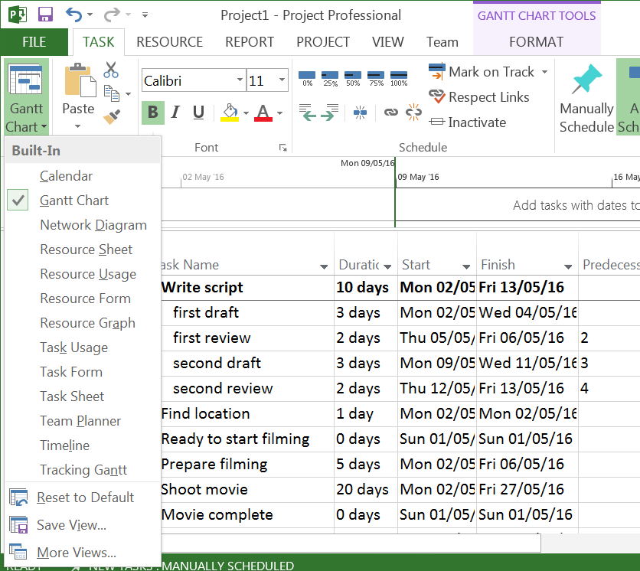
Adding Resources
Use the Microsoft Project Resource Sheet to create a list of the people, equipment, and materials that make up your team and carry out project tasks.
Create a Resource List.
Select the View menu,
click Resource Sheet.

Slide 28
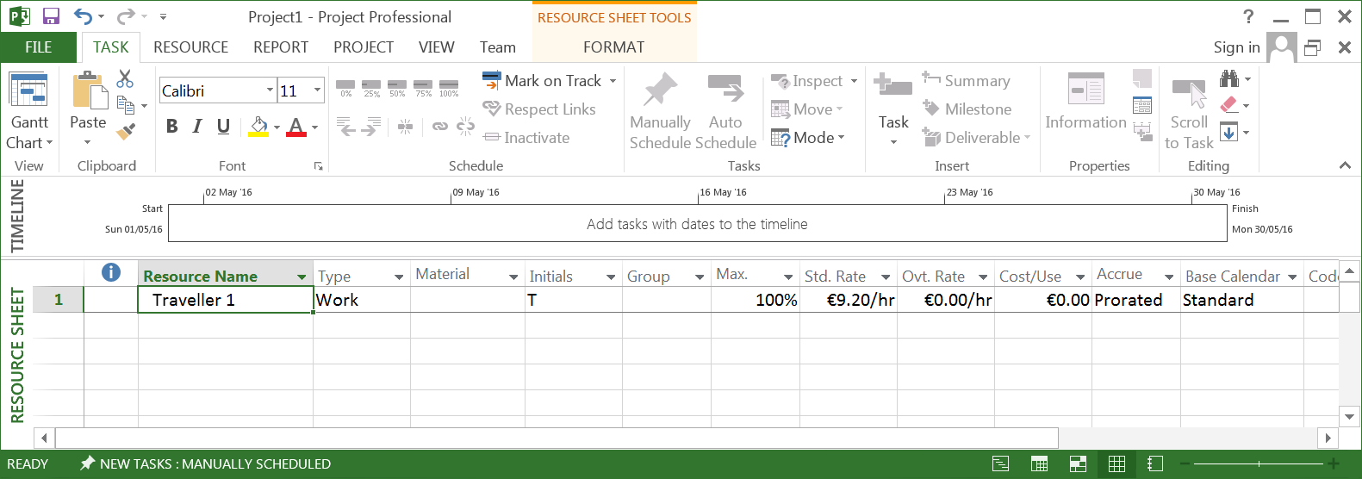
Adding Resources, Editing Resource Sheet
In the Resource Name field, type a resource name.
In the Type field, specify the resource type Work or Material
In the Std. Rate field, enter the pay rate.
Overtime rate can be set.
A cost per use amount can be set for a resource. This is a once off cost each time the resource is used.

Slide 29
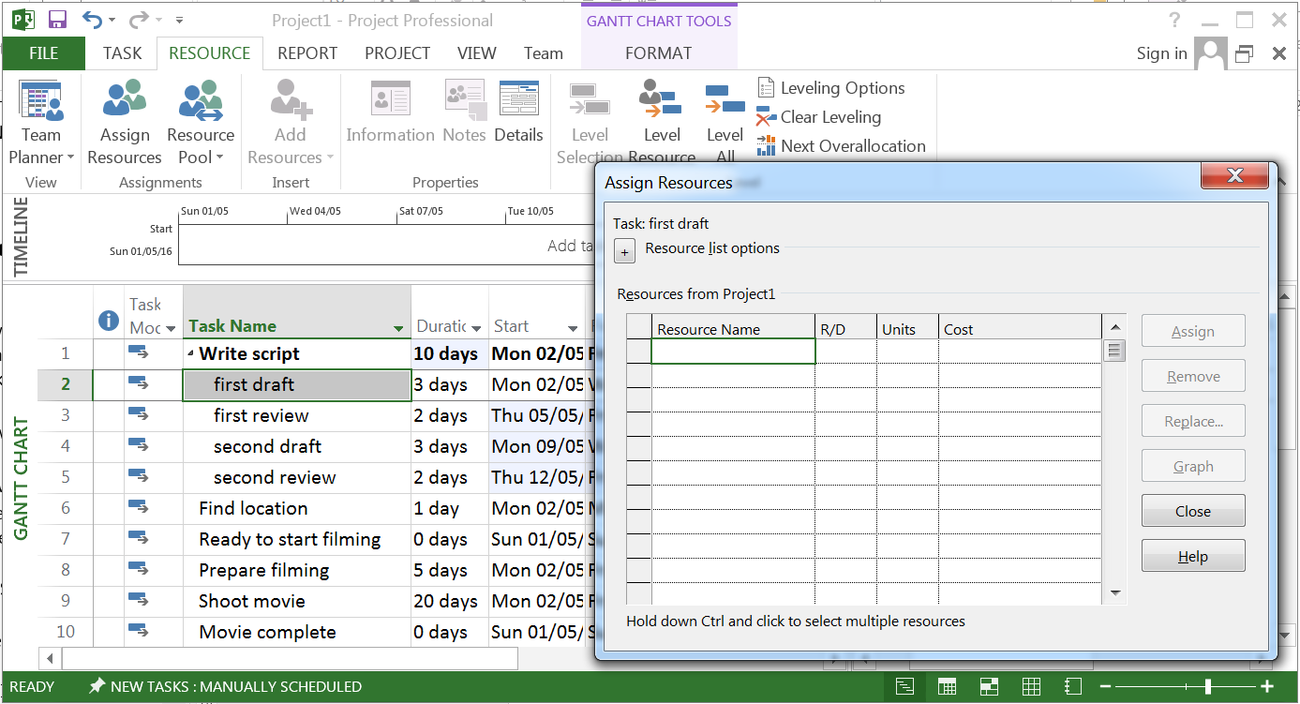
Assigning Resources
Assigning Resources to Tasks
On the View menu, click Gantt Chart.
In the Task Name field, click the task to which you want to assign a resource, and then click Resource tab and Assign Resources
In the Name field, select the resource you want to assign to the task and then click Assign.
To assign several different resources, hold down CTRL and click the names of the resources.

Slide 30
Costs
Microsoft Project allows you to assign rates to work resources and material resources so you can manage project costs accurately. You can assign standard rates, overtime rates, or peruse rates to resources.
Assigning costs to resources
On the View menu, click Resource Sheet.
On the View menu, point to Table, and then click Entry.
In the Resource Name field, select a resource or type a new resource name.
In the Type field, click Work if the resource is a person or machine, or Material if the resource is a quantity of consumable material or supplies (such as cement).
For a work resource, in the Std. Rate,Ovt. Rate, or Cost/Use fields, type the resource rates.
For a material resource, in the Material Label field, type a measurement unit for the material resource (such as ton), and in the Std.Rate or Cost/Use fields, type a rate.
Press ENTER.

Slide 31
Tracking Costs
To see the cost of a Resource or Tasks
On the View menu, click Resource Sheet.
To see task costs, on the View menu, click More Views, and then click Task Sheet
On the View menu, point to Table, and then click Cost.
See the cost of the entire project
On the Project menu, click Project Information.
Click Statistics.
Under Cost in the Current row, view the total planned cost of the project.

Slide 32
Lag, Lead and Slack Time
Lag time is used to introduce a delay between the completion of one task and the beginning of another.
When a foundation is poured some lag time is required to allow the cement to set before other activities on the foundation can begin.
Lag time increases the length of time it takes to complete a project
To add Lag time to a Task double click the dependency arrow leaving the task and add the required lag.
Lead time is used to start a task earlier than the finish time of a dependent task. Lead time is entered as negative Lag time
Slack time is the amount of time a task can move or slip before it affects the start or finish date of another task
Slack between tasks is termed Free Slack
The amount of time a task can slip before it delays the end date of a project is called Total Slack

Slide 33
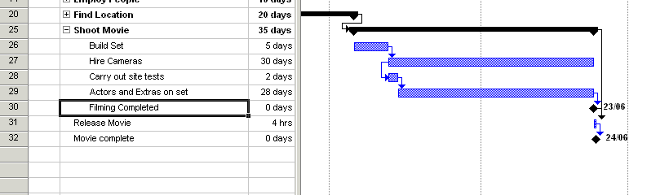
Adding 5 days Lag Time to the Build Set task and then adding 2 days Lead time – just click on the image

Slide 34
Baselines
A baseline is the set of original start and finish dates, durations, work and cost estimates that you save after you have completed and fine tuned your project
Because you will use the baseline to track your project you should ensure your estimates of time and costs are as accurate as possible
This acts as a reference point to see how your project is progressing against target.
To save the baseline you need to:
On Tools menu select Tracking
Under tracking select Save Baseline

